Slide 1
R-Analysis
ON
EPIDEMICS
(MALARIA AND HIV-AIDS)

Slide 2
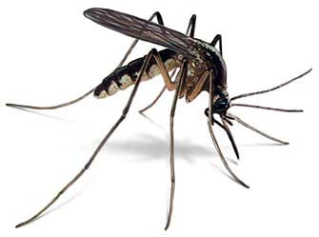
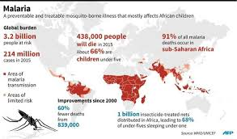
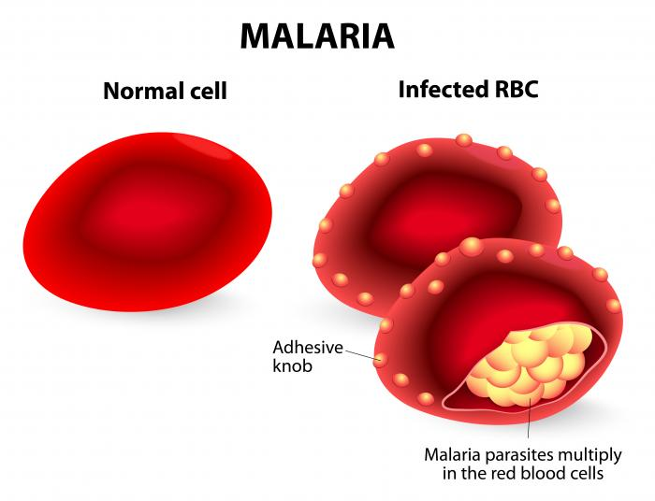
Malaria

Slide 3
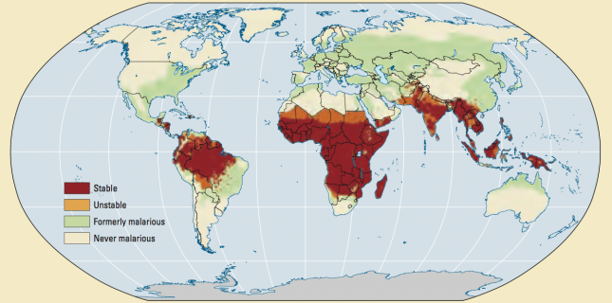
World map of past and current malaria prevalence – World Development Report

Slide 4
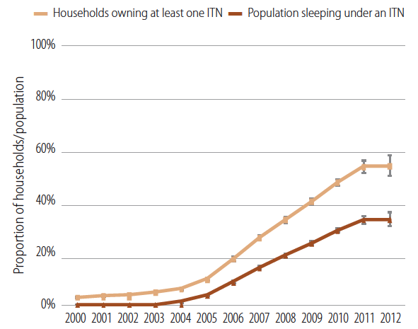
Estimated trend in proportion of households with at least one insecticide treated net (ITN) and proportion of the population sleeping under an ITN in sub-Saharan Africa, 2000-2012 – WHO (2012)

Slide 5
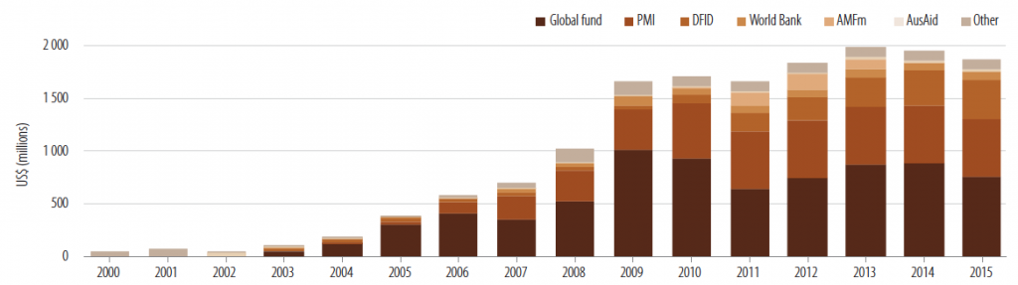
Past and projected international funding for malaria control, 2000-2015 – WHO (2012)

Slide 6
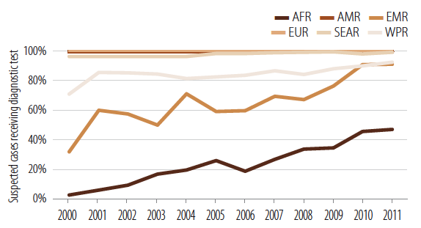
Proportion of suspected malaria cases attending public health facilities that receive a diagnostic test, 2000-2011 – WHO

Slide 7
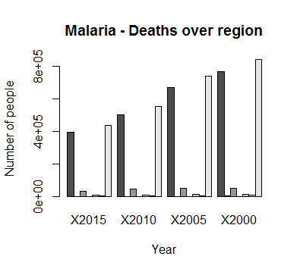
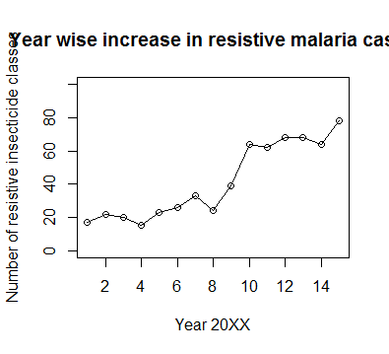

Slide 8
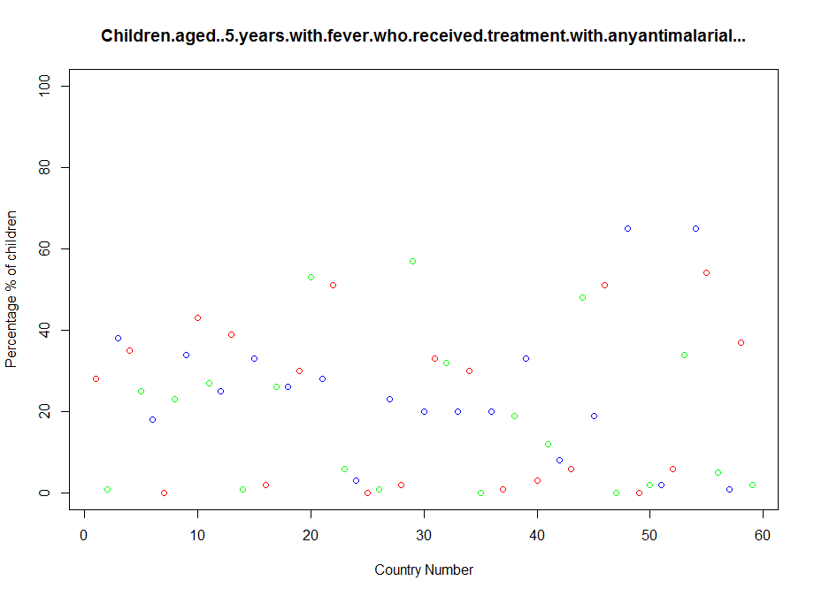

Slide 9
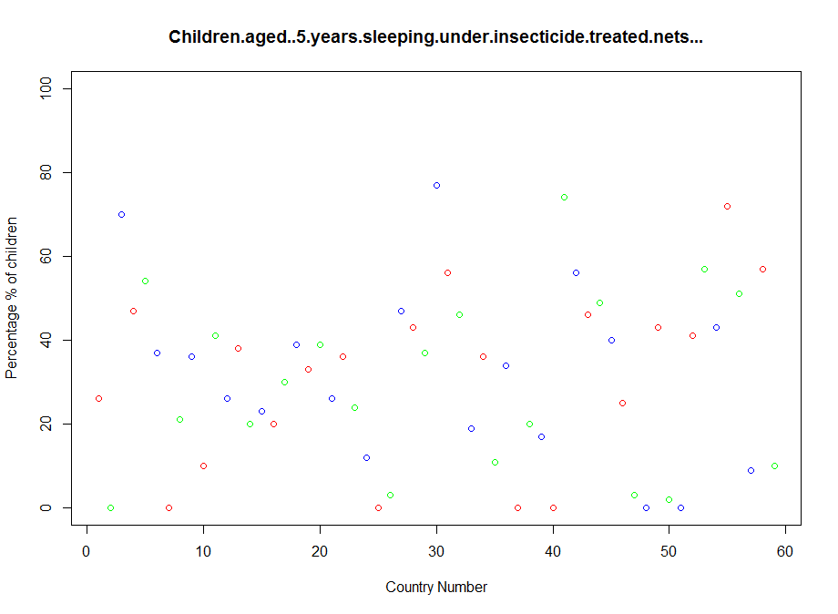

Slide 10

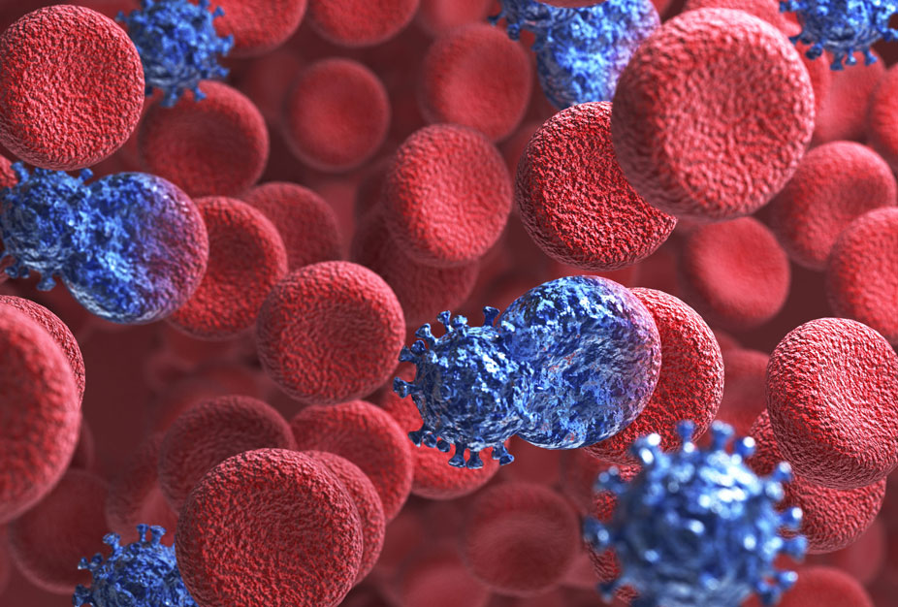

HIV-AIDS

Slide 11
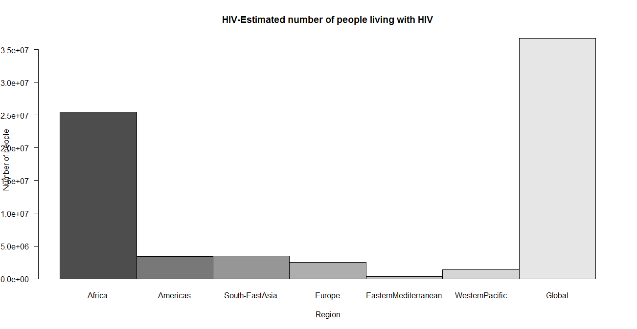

Slide 12
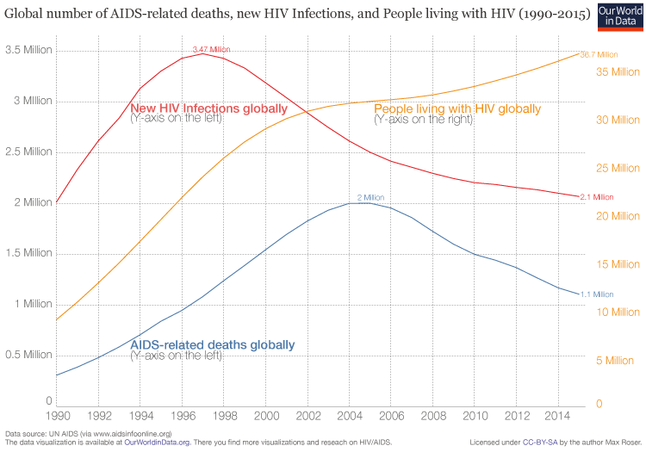

Slide 13
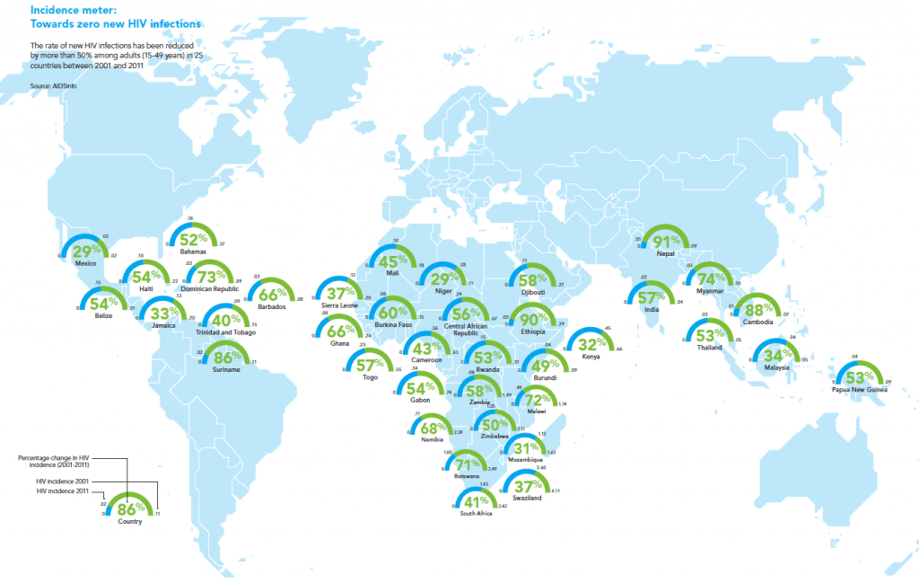

Slide 14
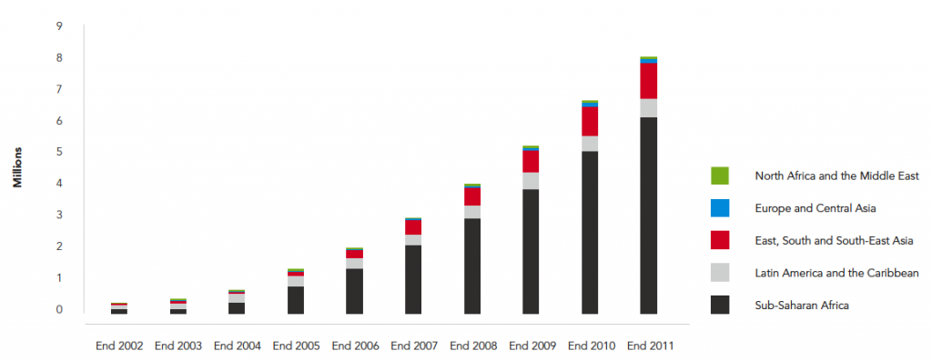
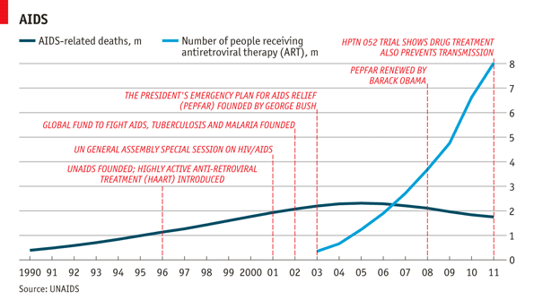
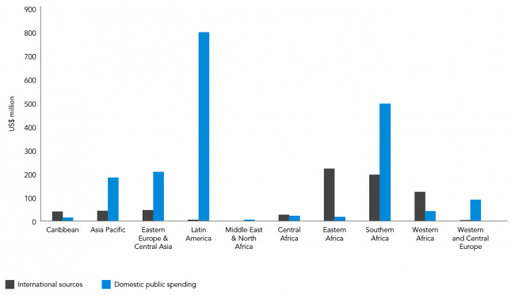
Antiretroviral Medicine

Slide 15
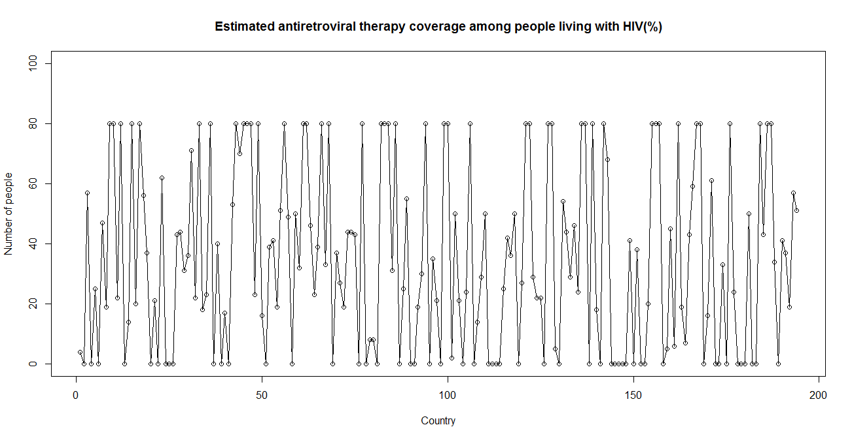

Slide 16
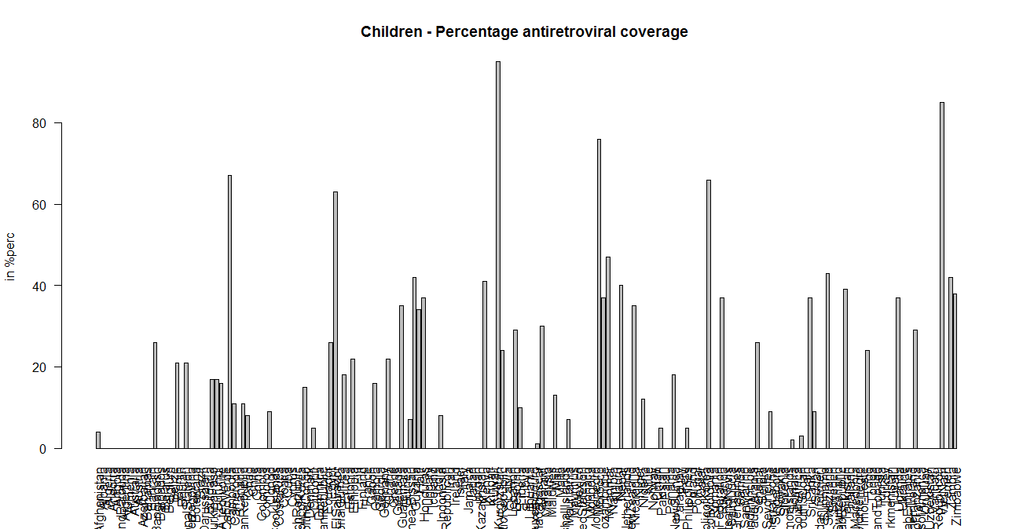

Slide 17
THANKYOU

